Slide 1
Multiplicity

Slide 2


Multiplicity – why does it matter?
https://xkcd.com/882/
FoS: Medical Affairs training

Slide 3
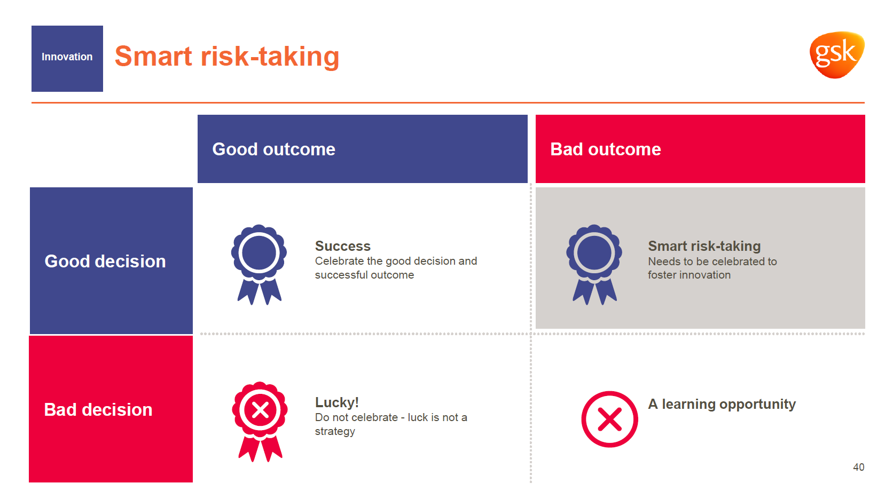
Smart risk-taking
Good outcome
Bad outcome
Good decision
Bad decision
FoS: Medical Affairs training

Slide 4
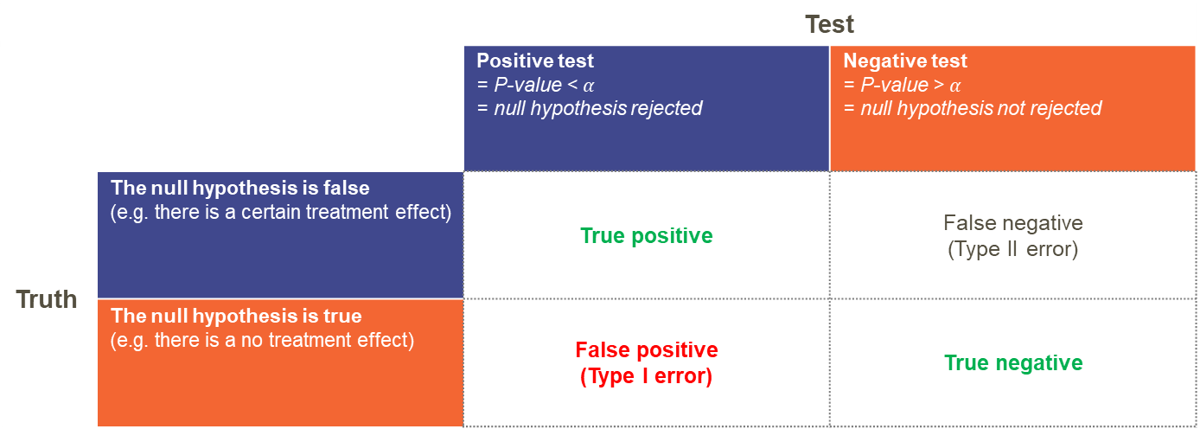
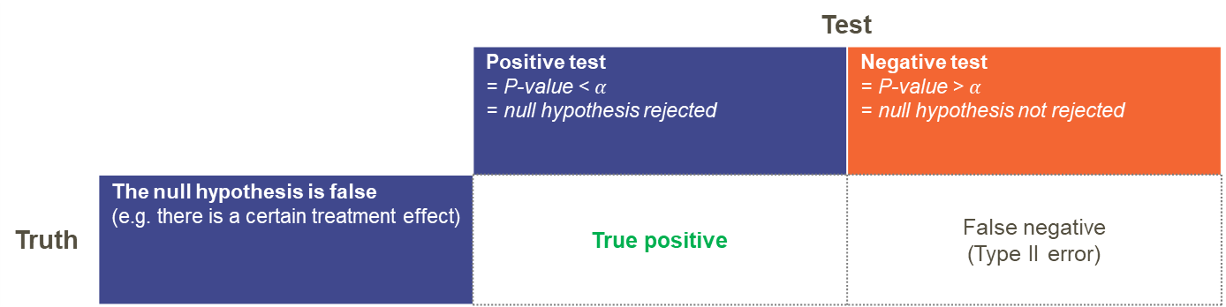
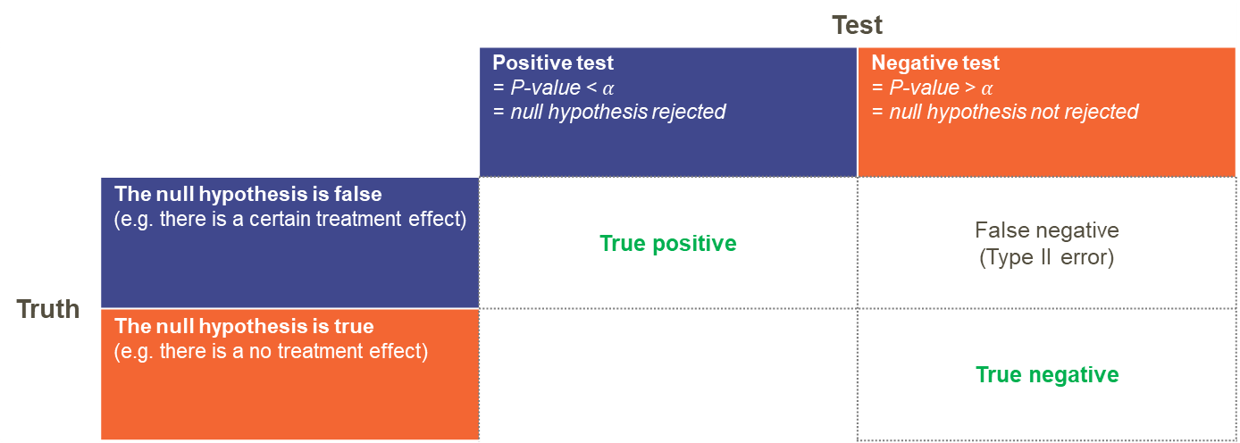
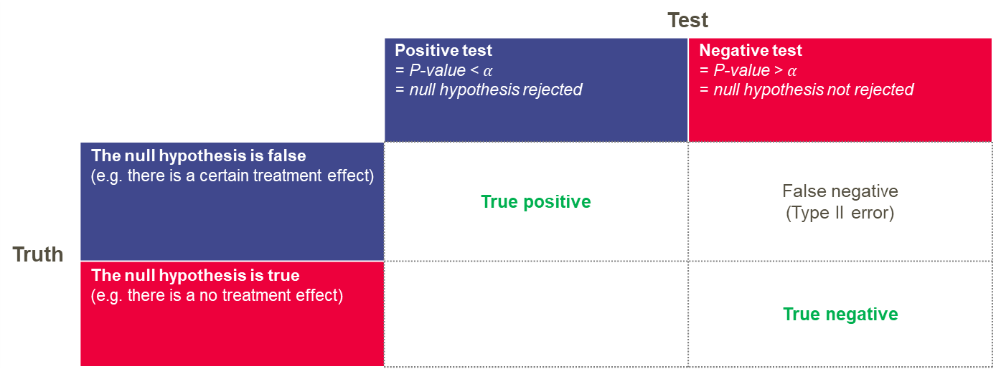

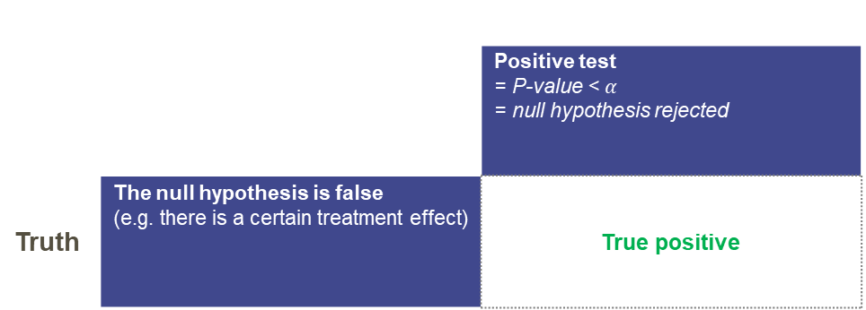
The language of testing
… so that we all understand each other
 |  | Test
 |  | Positive test = P-value < $α$ = null hypothesis rejected | Negative test = P-value > $α$ = null hypothesis not rejected
 |  | Test
 |  | Positive test = P-value < $α$ = null hypothesis rejected | Negative test = P-value > $α$ = null hypothesis not rejected
Truth | The null hypothesis is false (e.g. there is a certain treatment effect) | True positive | False negative (Type II error)
 | The null hypothesis is true (e.g. there is a no treatment effect) |  | True negative
 |  | Test
 |  | Positive test = P-value < $α$ = null hypothesis rejected | Negative test = P-value > $α$ = null hypothesis not rejected
Truth | The null hypothesis is false (e.g. there is a certain treatment effect) | True positive | False negative (Type II error)
 |  | Positive test = P-value < $α$ = null hypothesis rejected
Truth | The null hypothesis is false (e.g. there is a certain treatment effect) | True positive
Truth | The null hypothesis is false (e.g. there is a certain treatment effect)
 | The null hypothesis is true (e.g. there is a no treatment effect)
 |  | Test
 |  | Positive test = P-value < $α$ = null hypothesis rejected | Negative test = P-value > $α$ = null hypothesis not rejected
Truth | The null hypothesis is false (e.g. there is a certain treatment effect) | True positive | False negative (Type II error)
 | The null hypothesis is true (e.g. there is a no treatment effect) |  | True negative
 |  | Test
 |  | Positive test = P-value < $α$ = null hypothesis rejected | Negative test = P-value > $α$ = null hypothesis not rejected
Truth | The null hypothesis is false (e.g. there is a certain treatment effect) | True positive | False negative (Type II error)
 | The null hypothesis is true (e.g. there is a no treatment effect) | False positive (Type I error) | True negative

Slide 5


How can multiplicity be introduced?
Clinical trials have multiple objectives
several treatments or doses
several endpoints
same endpoint measured over time
several subgroups
several analyses
early stopping at interim for efficacy
adaptation of design features
FoS: Medical Affairs training

Slide 6
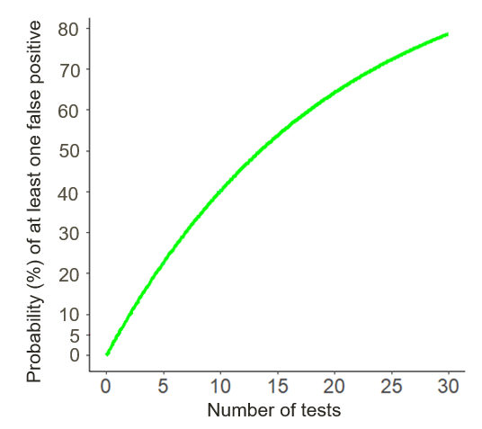
How likely are we to make the wrong decision?
Probability of declaring at least one false positive test, assuming the null hypothesis
What is the chance of at least one false positive result when the type 1 error rate per test is 5%?
For 1 test, the probability is 5%
For 5 tests, the probability is 23%
For 14 tests, the probability is 51%
Number of independent tests
FoS: Medical Affairs training

Slide 7

Knowledge Check
Subgroup | Categories
Gender | Male Female
Age (years) | <65 ≥65
Region | Europe Russia United States (USA) Rest of World (RoW)
Pre-study ICS dosage at screening | Mid High
Body Mass Index (BMI) | <25 kg/m² ≥25 kg/m²
CV History/Risk Factor at Screening | Yes No
alpha = 5% per test
Assuming the null hypothesis is true, what is the probability of seeing a positive treatment effect in at least one of these (independent) subgroups?
Approx. 26% (6 tests)
Approx. 51% (14 tests)
FoS: Medical Affairs training

Slide 8
Knowledge Check
Subgroup | Categories
Gender | Male Female
Age (years) | <65 ≥65
Region | Europe Russia United States (USA) Rest of World (RoW)
Pre-study ICS dosage at screening | Mid High
Body Mass Index (BMI) | <25 kg/m² ≥25 kg/m²
CV History/Risk Factor at Screening | Yes No
alpha = 5% per test
FoS: Medical Affairs training

Slide 9
Some Common Methods to Handle Multiplicity
Bonferroni – divides alpha equally between tests, so higher hurdle to achieve for each test (“or” framework)
Hierarchies and Graphical Procedures – test sequentially (“and” framework)
Step-up/Step-down procedures (Hochburg/Holm)
And there are many more….
Interested in learning more?
  Check out the FoS multiplicity webinar on the Keep Growing Campus.
If you have questions for your project – ask your Statistician!
FoS: Medical Affairs training

Slide 10
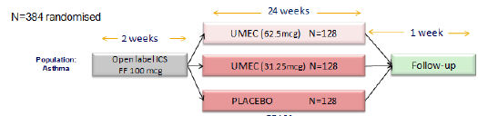
Example: Hierarchical Testing
Trelegy Asthma Study 205832: Hierarchy
Change from baseline in FEV1 at Week 24:
UMEC 62.5 vs Placebo
α=0.05
Change from baseline in FEV1 at Week 24:
UMEC 31.25 vs Placebo
α=0.05
FoS: Medical Affairs training

Slide 11
Example: Hierarchical Testing
Change from baseline in FEV1 at Week 24:
UMEC 62.5 vs Placebo
α=0.05
Change from baseline in FEV1 at Week 24:
UMEC 31.25 vs Placebo
α=0.05
Trelegy Asthma Study 205832: Hierarchy
Change from baseline in FEV1 at Week 24:
UMEC 62.5 vs Placebo
P<0.001
Change from baseline in FEV1 at Week 24:
UMEC 31.25 vs Placebo
P<0.001
Statistically significant?
Multiplicity adjustment:
UMEC 62.5mcg | UMEC 31.25mcg
Change from baseline in FEV1 at Week 24:
UMEC 62.5 vs Placebo
P<0.001
Change from baseline in FEV1 at Week 24:
UMEC 31.25 vs Placebo
P=0.074
✓
✓
Results scenario 1:
Change from baseline in FEV1 at Week 24:
UMEC 62.5 vs Placebo
P=0.074
Change from baseline in FEV1 at Week 24:
UMEC 31.25 vs Placebo
P<0.001
✓
✗
Results scenario 2:
✗
✗
Results scenario 3:
FoS: Medical Affairs training

Slide 12
Example: Hierarchical Testing
Trelegy Asthma Study 205832: Hierarchy
“In order to account for multiple tests involving the two UMEC doses a step-down testing procedure will be applied whereby inference for a test in the pre-defined hierarchy is dependent upon statistical significance having been achieved for the previous test in the hierarchy.
A step-down procedure with the following hierarchy will be used for the primary comparisons in the primary endpoint
The contrast between UMEC 62.5 mcg vs Placebo (two-sided, alpha = 0.05. Null hypothesis of no treatment difference)
The contrast between UMEC 31.25 mcg vs Placebo (two-sided, alpha = 0.05. Null hypothesis of no treatment difference)
The second hypothesis will be formally tested only if the first hypothesis has been rejected, thus maintaining the overall significance level at 5%. Specifically, if the defined treatment comparison for the primary efficacy endpoint at the highest dose of UMEC 62.5 mcg is significant at 0.05 level then the efficacy of UMEC 62.5 mcg is demonstrated, and the treatment comparison can be repeated on the UMEC 31.25 mcg dose. Note that, in the event that the first hypothesis is not rejected a nominal p-value for the second hypothesis may be provided in the displays for descriptive purposes only and will not alter the conclusion of the step-down procedure.”
FoS: Medical Affairs training

Slide 13
Example: Bonferroni Adjustment
Type I error=0.05
Endpoint 1:
Treatment vs Placebo
Type I error=0.025
Endpoint 2:
Treatment vs Placebo
Type I error=0.025

Slide 14
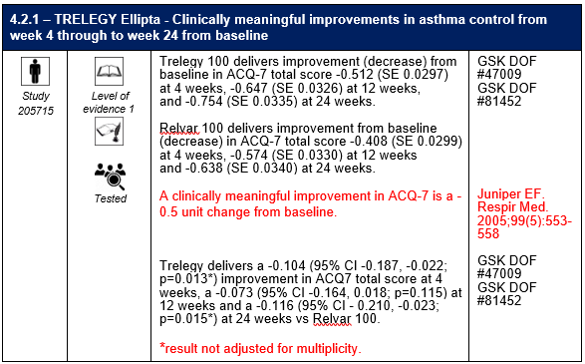
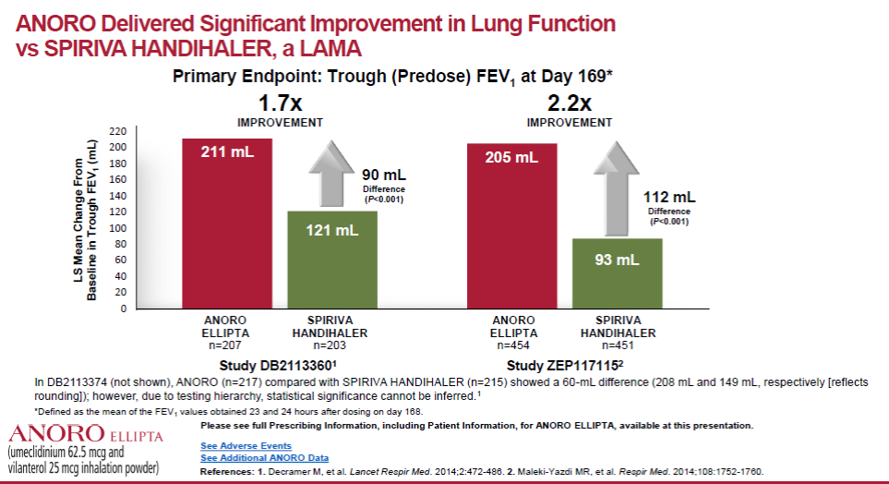
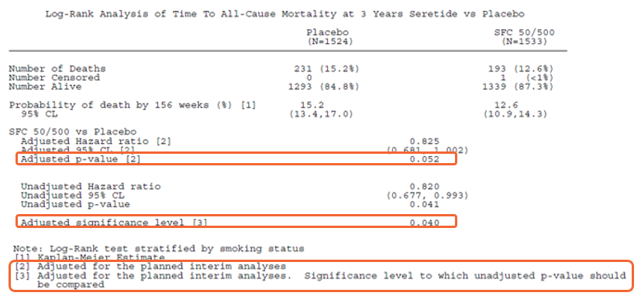
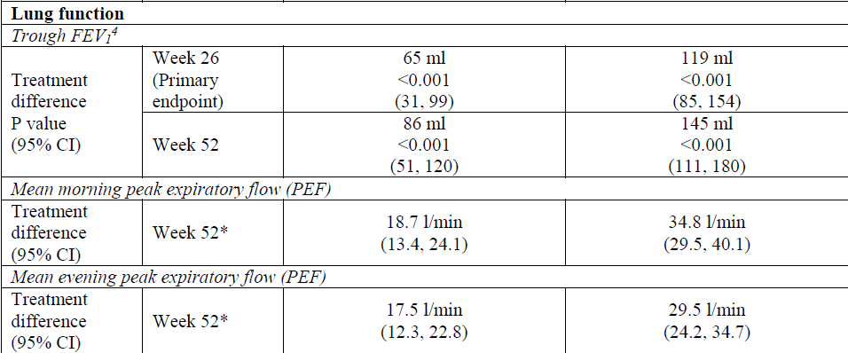
What to look out for…
FoS: Medical Affairs training

Slide 15



How do we know whether to believe the data?
Interpreting data
If a positive result is seen in an unadjusted endpoint, consider:
Was it pre-specified or post-hoc?
Magnitude of the result
Biological plausibility
Replication (other studies/external literature)?
Consistency (associated endpoints/similar drugs)?

Slide 16
Knowledge Check
Which of these is a source of multiplicity in a clinical study?
  More than one endpoint
  More than one dose of experimental treatment
  Interim analysis
  Subgroup analyses
  All of the above
FoS: Medical Affairs training

Slide 17
Knowledge Check
Why is multiplicity an issue?
  It’s not an issue in phase 3
  The result may be a false negative
  The result may be a false positive
  The study may be underpowered
  We may incorrectly accept the null hypothesis
FoS: Medical Affairs training

Slide 18
Knowledge Check
The following result is reported. What can we claim?
“Treatment A reduced the annualised rate of severe exacerbations by 22% (p=0.050) compared with Treatment B”
  There is a statistically significant reduction in severe exacerbations
  There is a clinically meaningful reduction in severe exacerbations
  There is not enough information provided to answer
  There is no reduction in severe exacerbations
FoS: Medical Affairs training

Slide 19
Key Messages
Multiplicity
What do you need to do?
Transparency is needed when presenting our results
It has to be tackled early on in study design
It has to be tackled as a team
Multiplicity issues exist in almost every study
Multiplicity is not just a statistical problem, it impacts what you claim, what data is in the label and what data you can promote on
It has to be considered when interpreting and communicating data
There is not one single best strategy
Be aware of multiplicity when interpreting competitor data
If in doubt: Talk to your statistician!

